Slide 1
Classification in Big Data Environments
Automated Machine Learning Seminar Presentation
Clemens Damke

Slide 2
Overview
Speedup via:
Hyperparameter Optimization
Optimizing Training

Slide 3



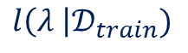
Hyperparameter Optimization
Naive Approaches:
Grid Search
Random Search
$$l\left(λ \right|𝒟_{train})$$

Slide 4
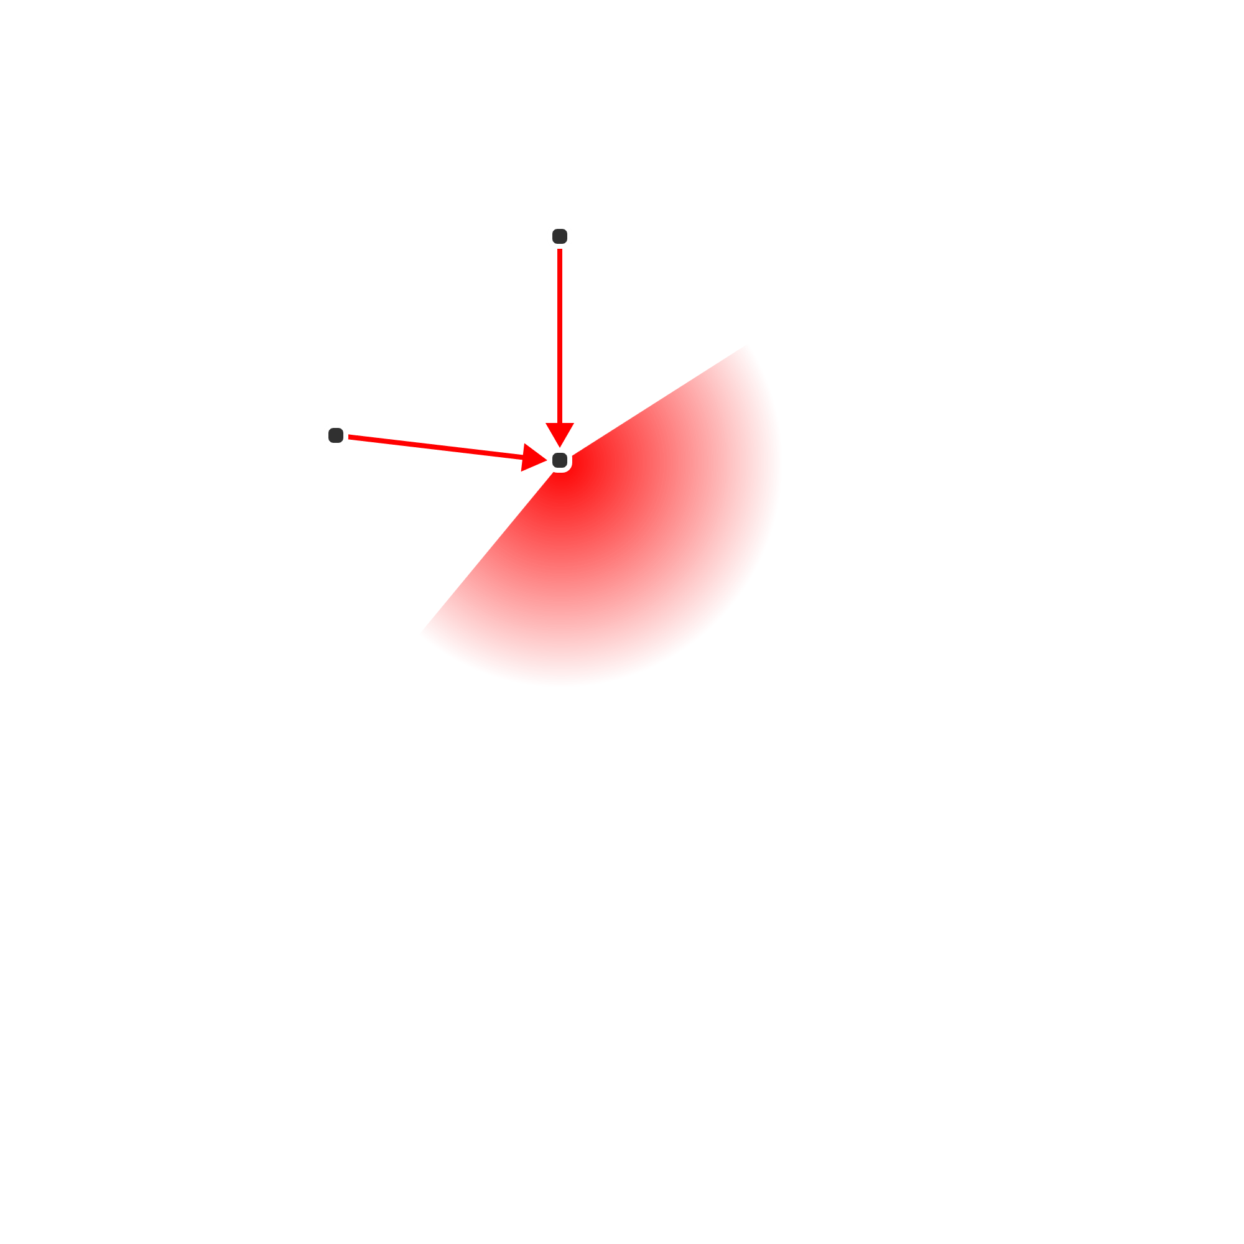

Hyperparameter Optimization
Naive Approaches:
Grid Search
Random Search
Optimization Ideas:
Estimate good probing positions
Terminate bad probes early
$$l\left(λ \right|𝒟_{train})$$

Slide 5

FABOLAS (Fast Bayesian Optimization of Machine Learning Hyperparameters on Large Datasets)
2 main ideas:
Model loss $l\left(λ \right|D_{train})$ as a Gaussian process
Model training set size $s∈[0,1]$ as additional hyperparameter

Slide 6
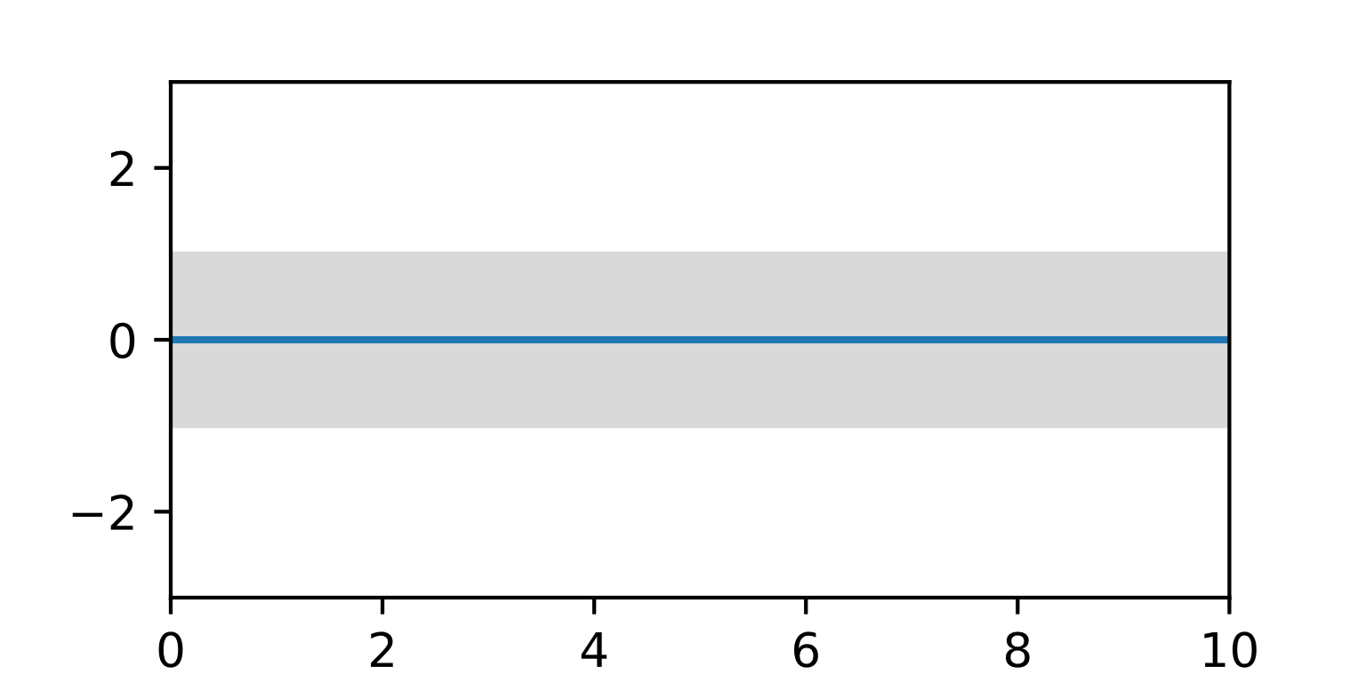

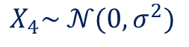
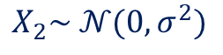
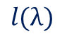

FABOLAS: Gaussian processes
$l$ modeled by covariant random variables:
$$X_{2}\sim 𝒩(0, σ^{2})$$
$$X_{4}\sim 𝒩(0, σ^{2})$$
$$l(λ)$$
$$λ$$

Slide 7
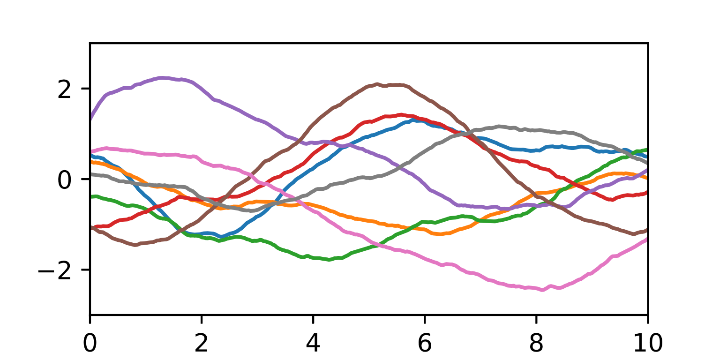
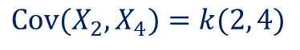
FABOLAS: Gaussian processes
$l$ modeled by covariant random variables:
$${\text{Cov}(X}_{2},X_{4})=k(2, 4)$$
$$l(λ)$$
$$λ$$

Slide 8
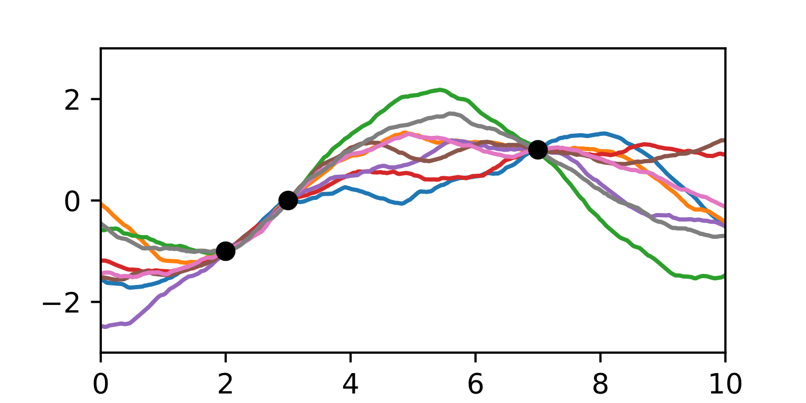
FABOLAS: Gaussian processes
Samples after 3 observations:
$$l(λ)$$
$$λ$$

Slide 9
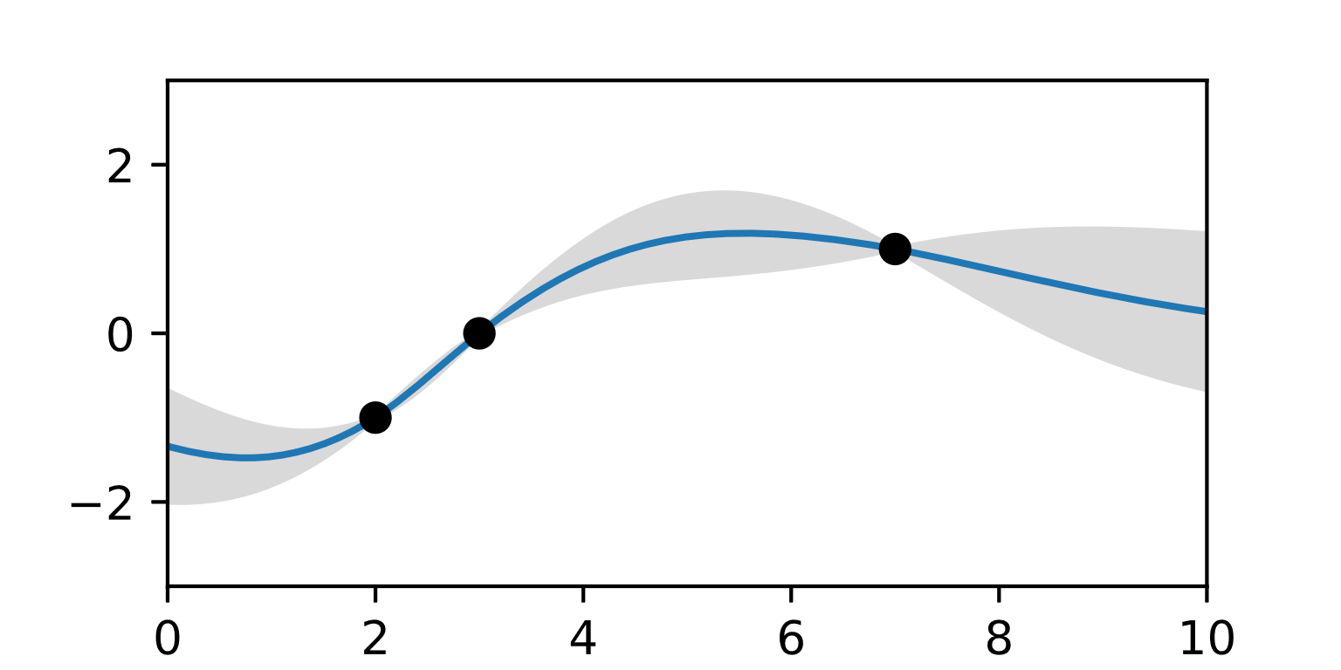
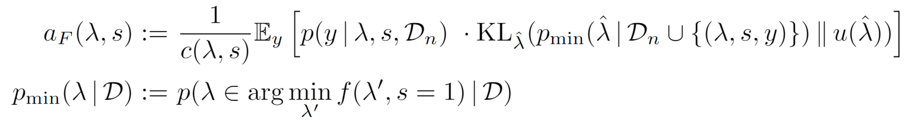

FABOLAS: Gaussian processes
Posterior distribution:
Promising position, according to $a_{F}$
$$l(λ)$$
$$λ$$

Slide 10
FABOLAS (Fast Bayesian Optimization of Machine Learning Hyperparameters on Large Datasets)
2 main ideas:
Model loss $l\left(λ \right|D_{train})$ as a Gaussian process
Model training set size $s∈[0,1]$ as additional hyperparameter

Slide 11
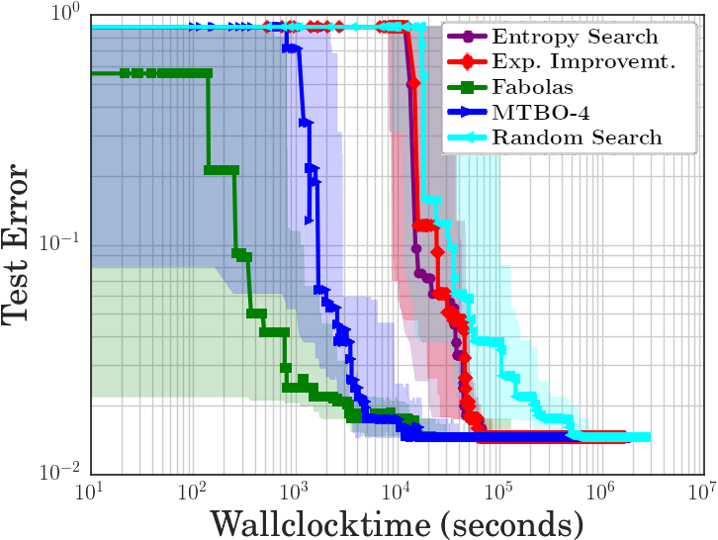
FABOLAS: Evaluation
Evaluation on MNIST using SVMs

Slide 12
Hyperparameter Optimization
Optimization Ideas:
FABOLAS
Terminate bad probes early
$$l\left(λ \right|𝒟_{train})$$

Slide 13
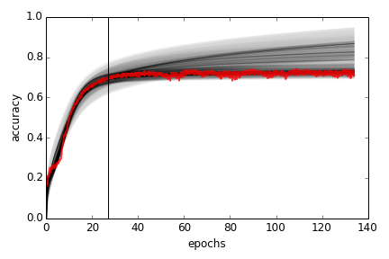
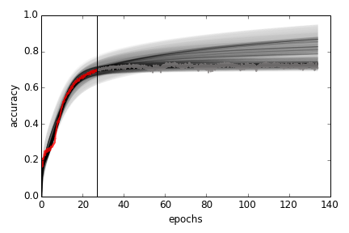
Learning Curve Extrapolation: Basic Idea
Best result so far
Increasing,
saturating
function
Gradient descent learning curve

Slide 14
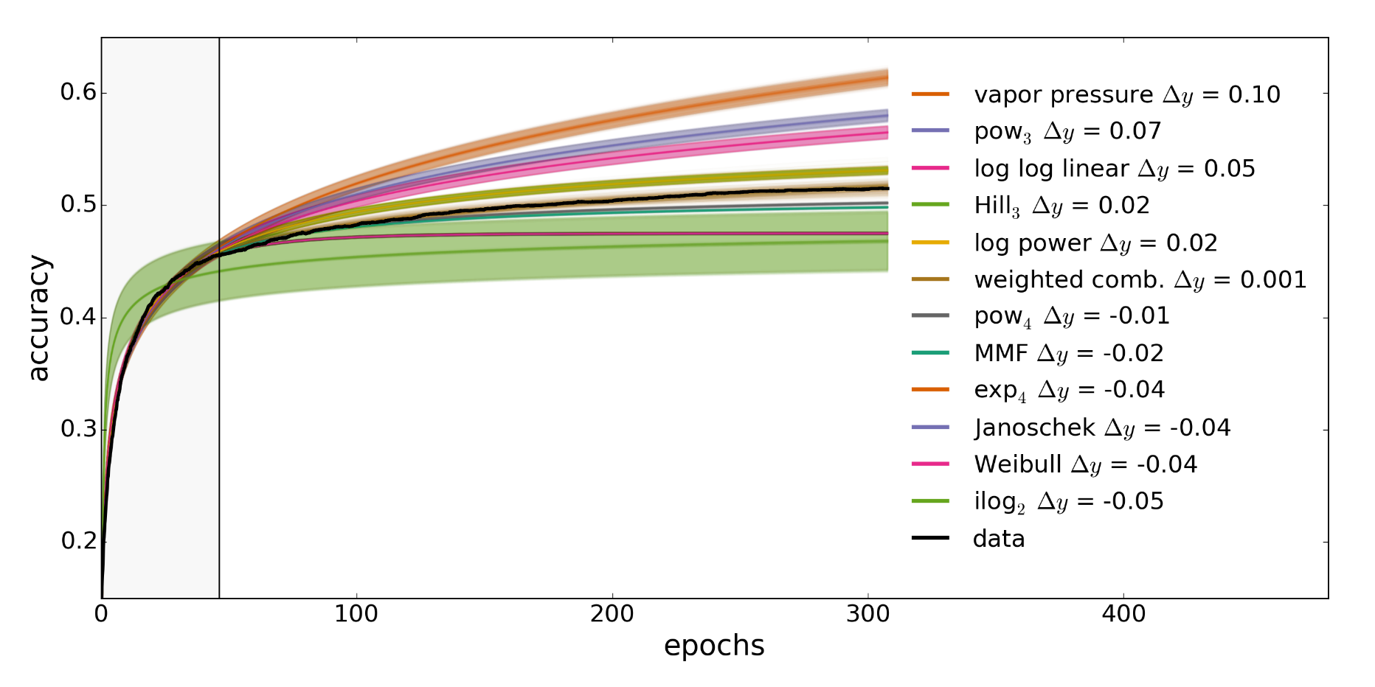
Learning Curve Extrapolation: Basic Idea
Fit a linear combination of increasing & saturating functions

Slide 15
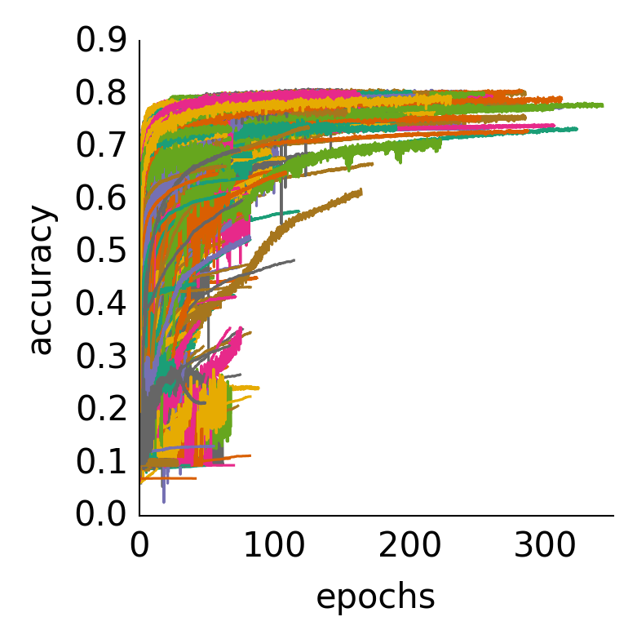
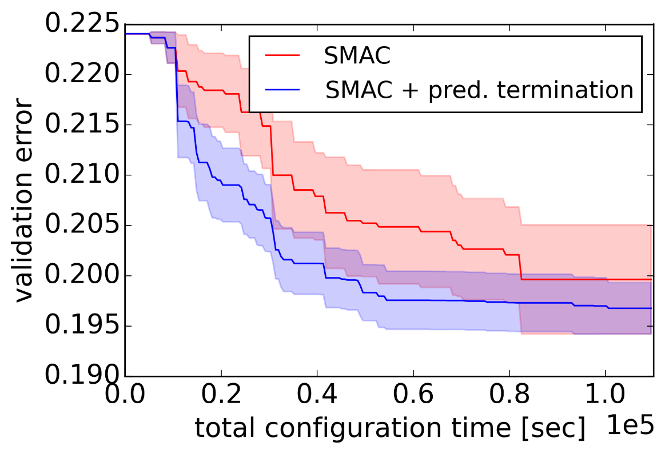
Learning Curve Extrapolation: Evaluation
Evaluation on CIFAR-10 using fully connected NNs

Slide 16
Overview
Speedup via:
Hyperparameter Optimization
Optimizing Training

Slide 17

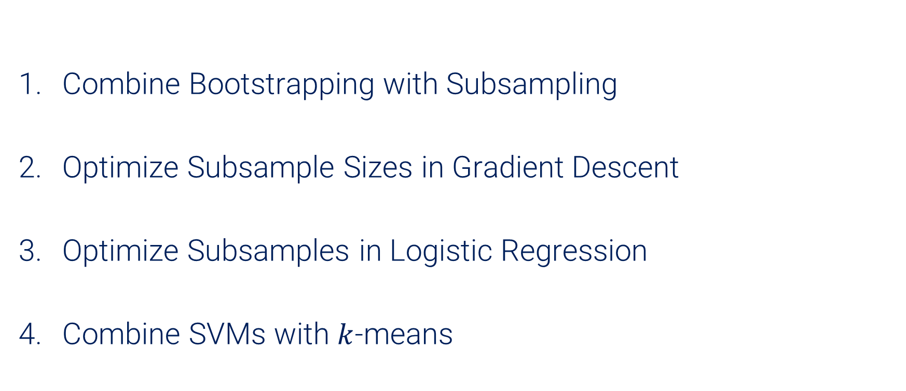
Optimizing Training: 4 approaches
Combine Bootstrapping with Subsampling
Optimize Subsample Sizes in Gradient Descent
Optimize Subsamples in Logistic Regression
Combine SVMs with $k$-means
Reduce size of $𝒟_{train}$

Slide 18
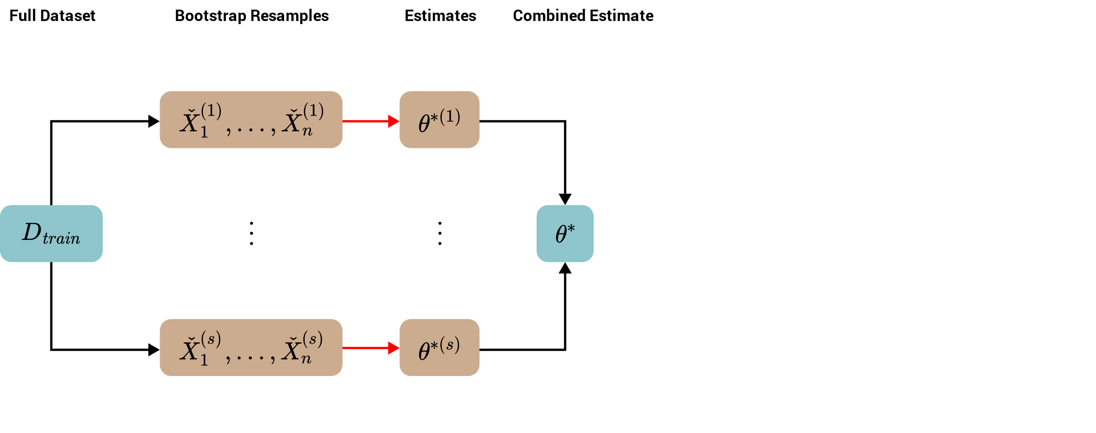

Regular $n$ out of $n$ Bootstrap (BOOT)
Can reduce variance.
But no speedup.

Slide 19
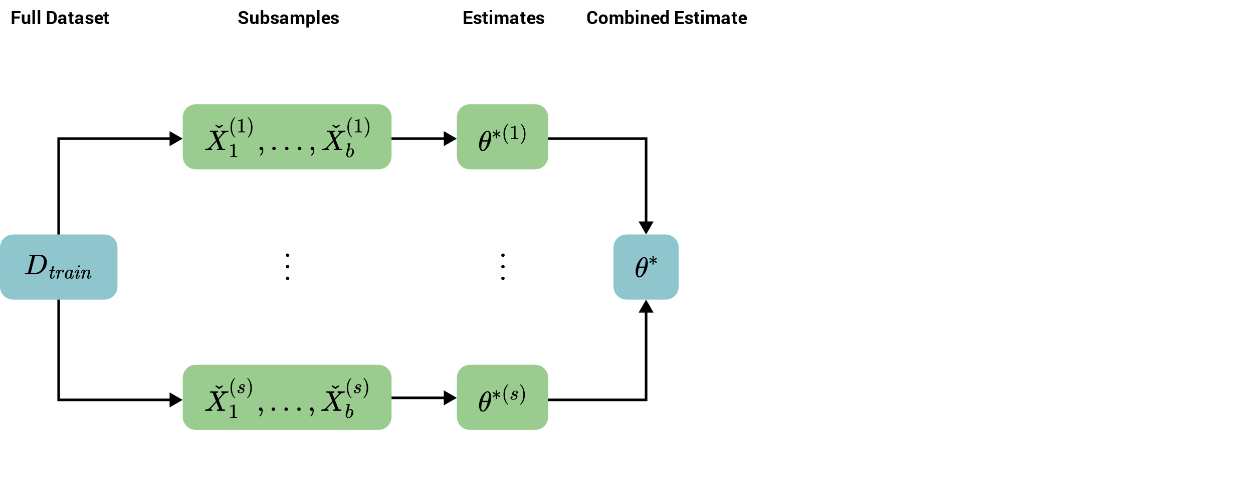
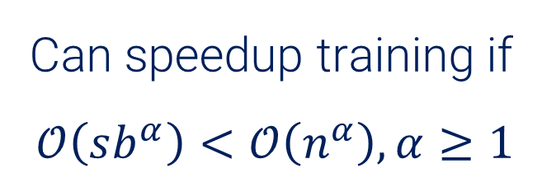


$b$ out of $n$ Bootstrap (BOFN)
Can speedup training if
$$𝒪\left(sb^{α}\right)<𝒪\left(n^{α}\right), α≥1$$
Sensitive to choice of $b$!

Slide 20
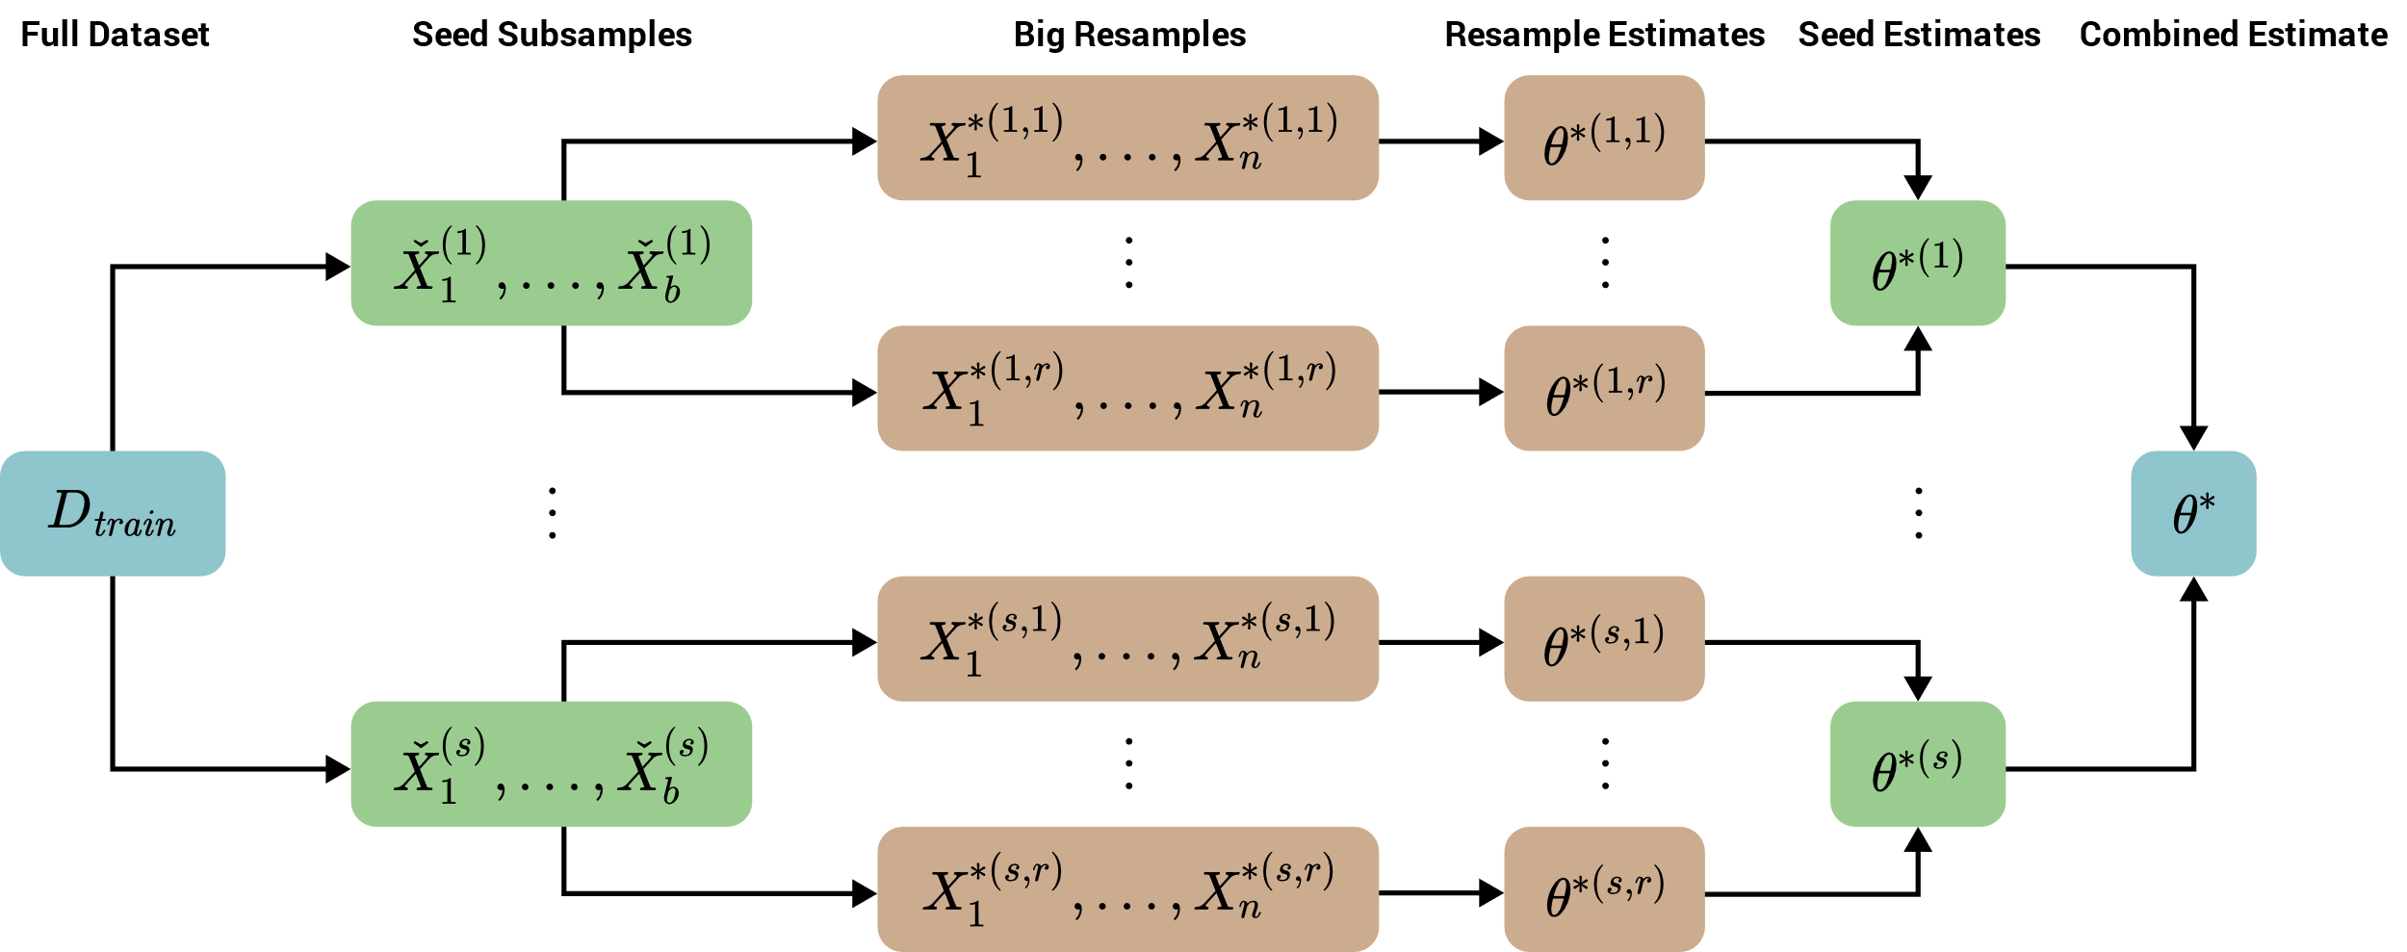
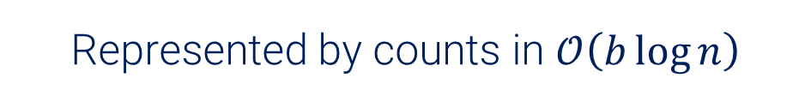
Bag of Little Bootstraps (BLB)
Represented by counts in $𝒪\left(b\log{n}\right)$

Slide 21
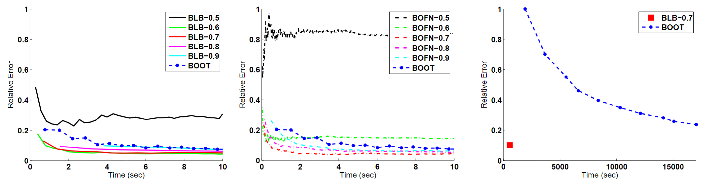
Bag of Little Bootstraps: Evaluation
Single Threaded (on a small dataset)
Parallelized (big dataset)
Evaluated using Logistic Regression on a randomly generated dataset

Slide 22
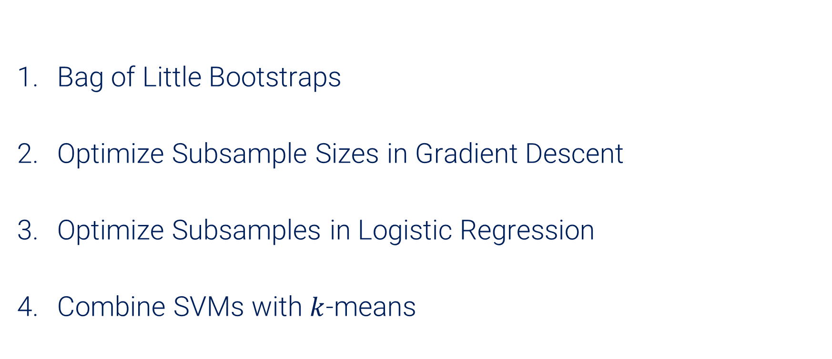
Optimizing Training: 4 approaches
Bag of Little Bootstraps
Optimize Subsample Sizes in Gradient Descent
Optimize Subsamples in Logistic Regression
Combine SVMs with $k$-means
Reduce size of $𝒟_{train}$

Slide 23
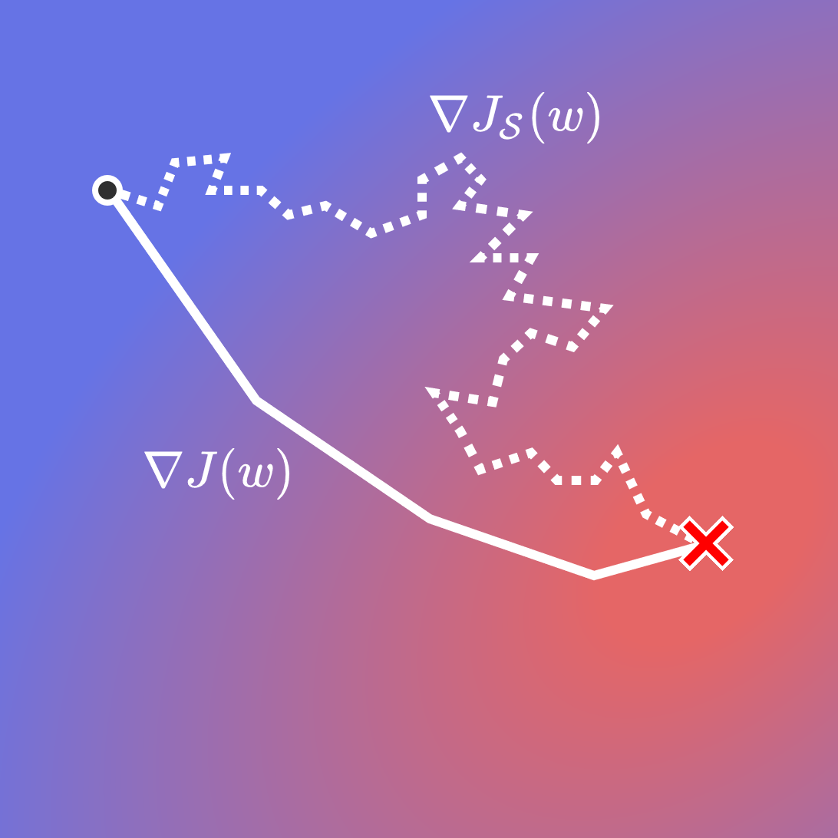

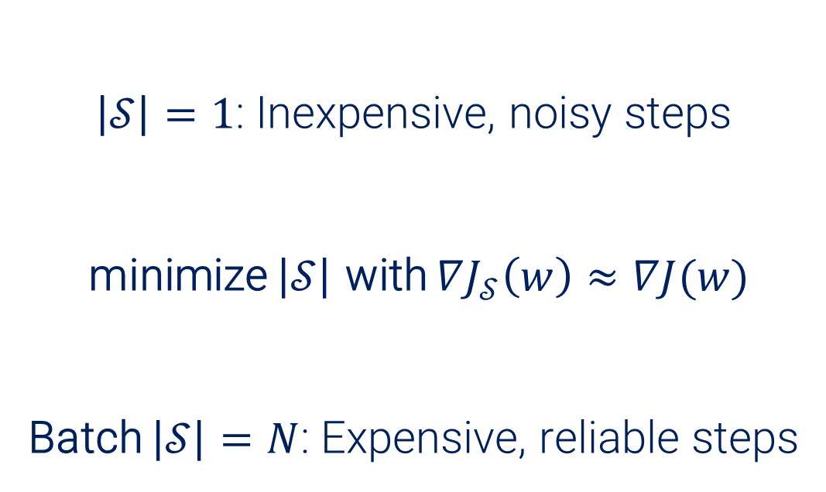
Sample Size Selection for Gradient Descent
$\left|𝒮\right|=1$: Inexpensive, noisy steps
minimize $\left|𝒮\right|$ with $∇J_{𝒮}\left(w\right)≈∇J(w)$
Batch $\left|𝒮\right|=N$: Expensive, reliable steps
$$\left|𝒮\right|$$

Slide 24
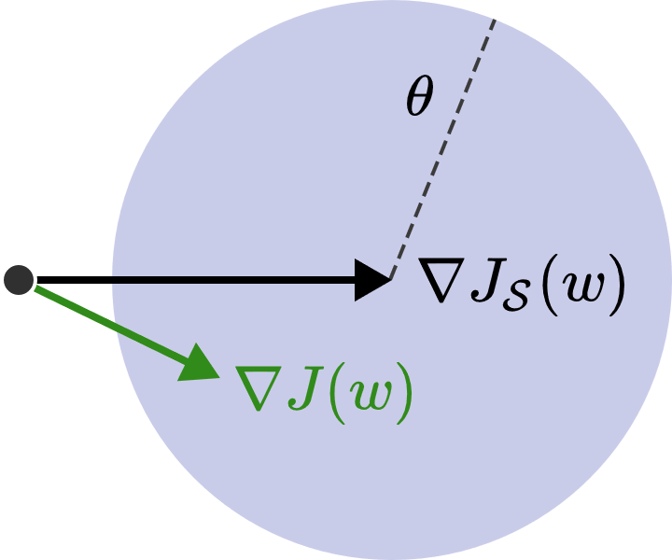
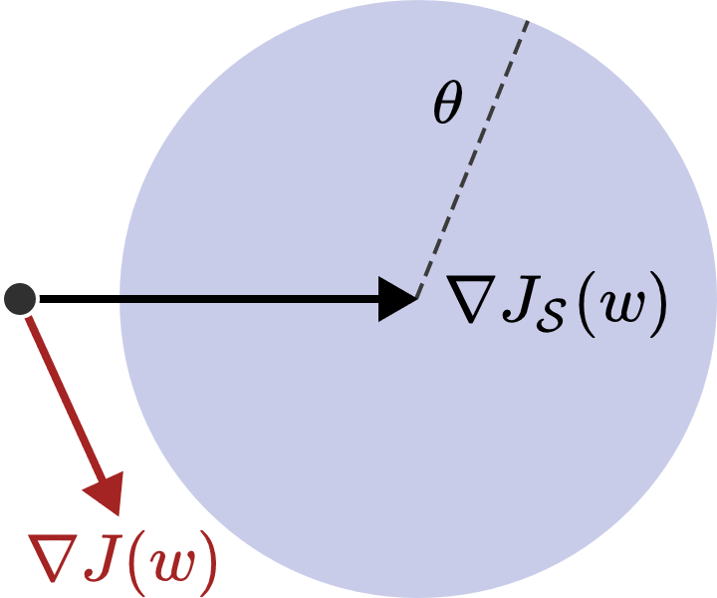
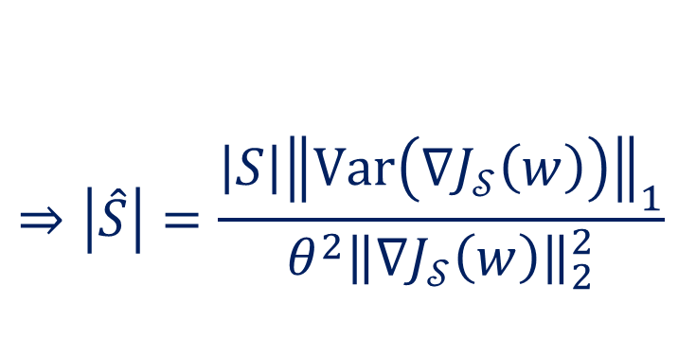
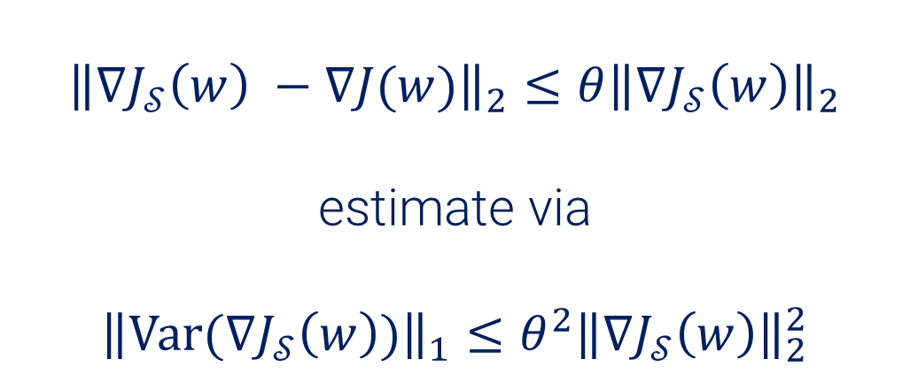
Sample Size Selection for Gradient Descent
$${\left\|∇J_{𝒮}\left(w\right) −∇J(w)\right\|}_{2}≤θ{\left\|∇J_{𝒮}\left(w\right)\right\|}_{2}$$
estimate via
$${\left\|\text{Var}(∇J_{𝒮}\left(w\right))\right\|}_{1}≤θ^{2}{\left\|∇J_{𝒮}\left(w\right)\right\|}_{2}^{2}$$
$$⇒\left|\hat{S}\right|=\frac{{\left|S\right|\left\|\text{Var}\left(∇J_{𝒮}\left(w\right)\right)\right\|}_{1}}{θ^{2}{\left\|∇J_{𝒮}\left(w\right)\right\|}_{2}^{2}}$$

Slide 25
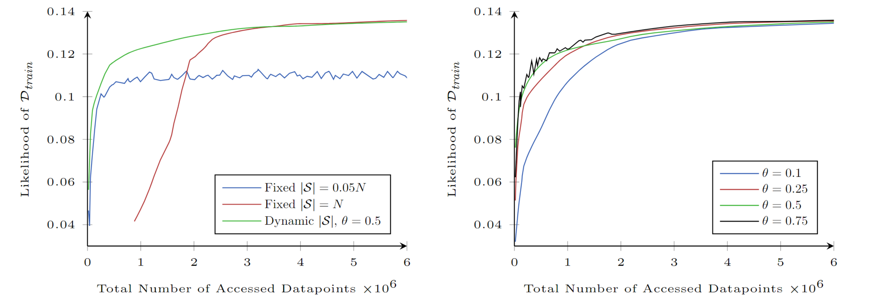
Sample Size Selection: Evaluation
Evaluation on a multi-class Logistic Regression task

Slide 26
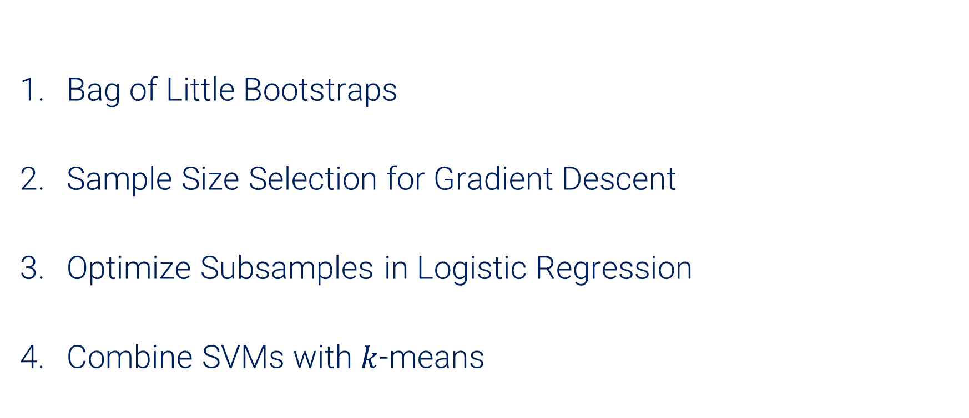
Optimizing Training: 4 approaches
Bag of Little Bootstraps
Sample Size Selection for Gradient Descent
Optimize Subsamples in Logistic Regression
Combine SVMs with $k$-means
Reduce size of $𝒟_{train}$

Slide 27
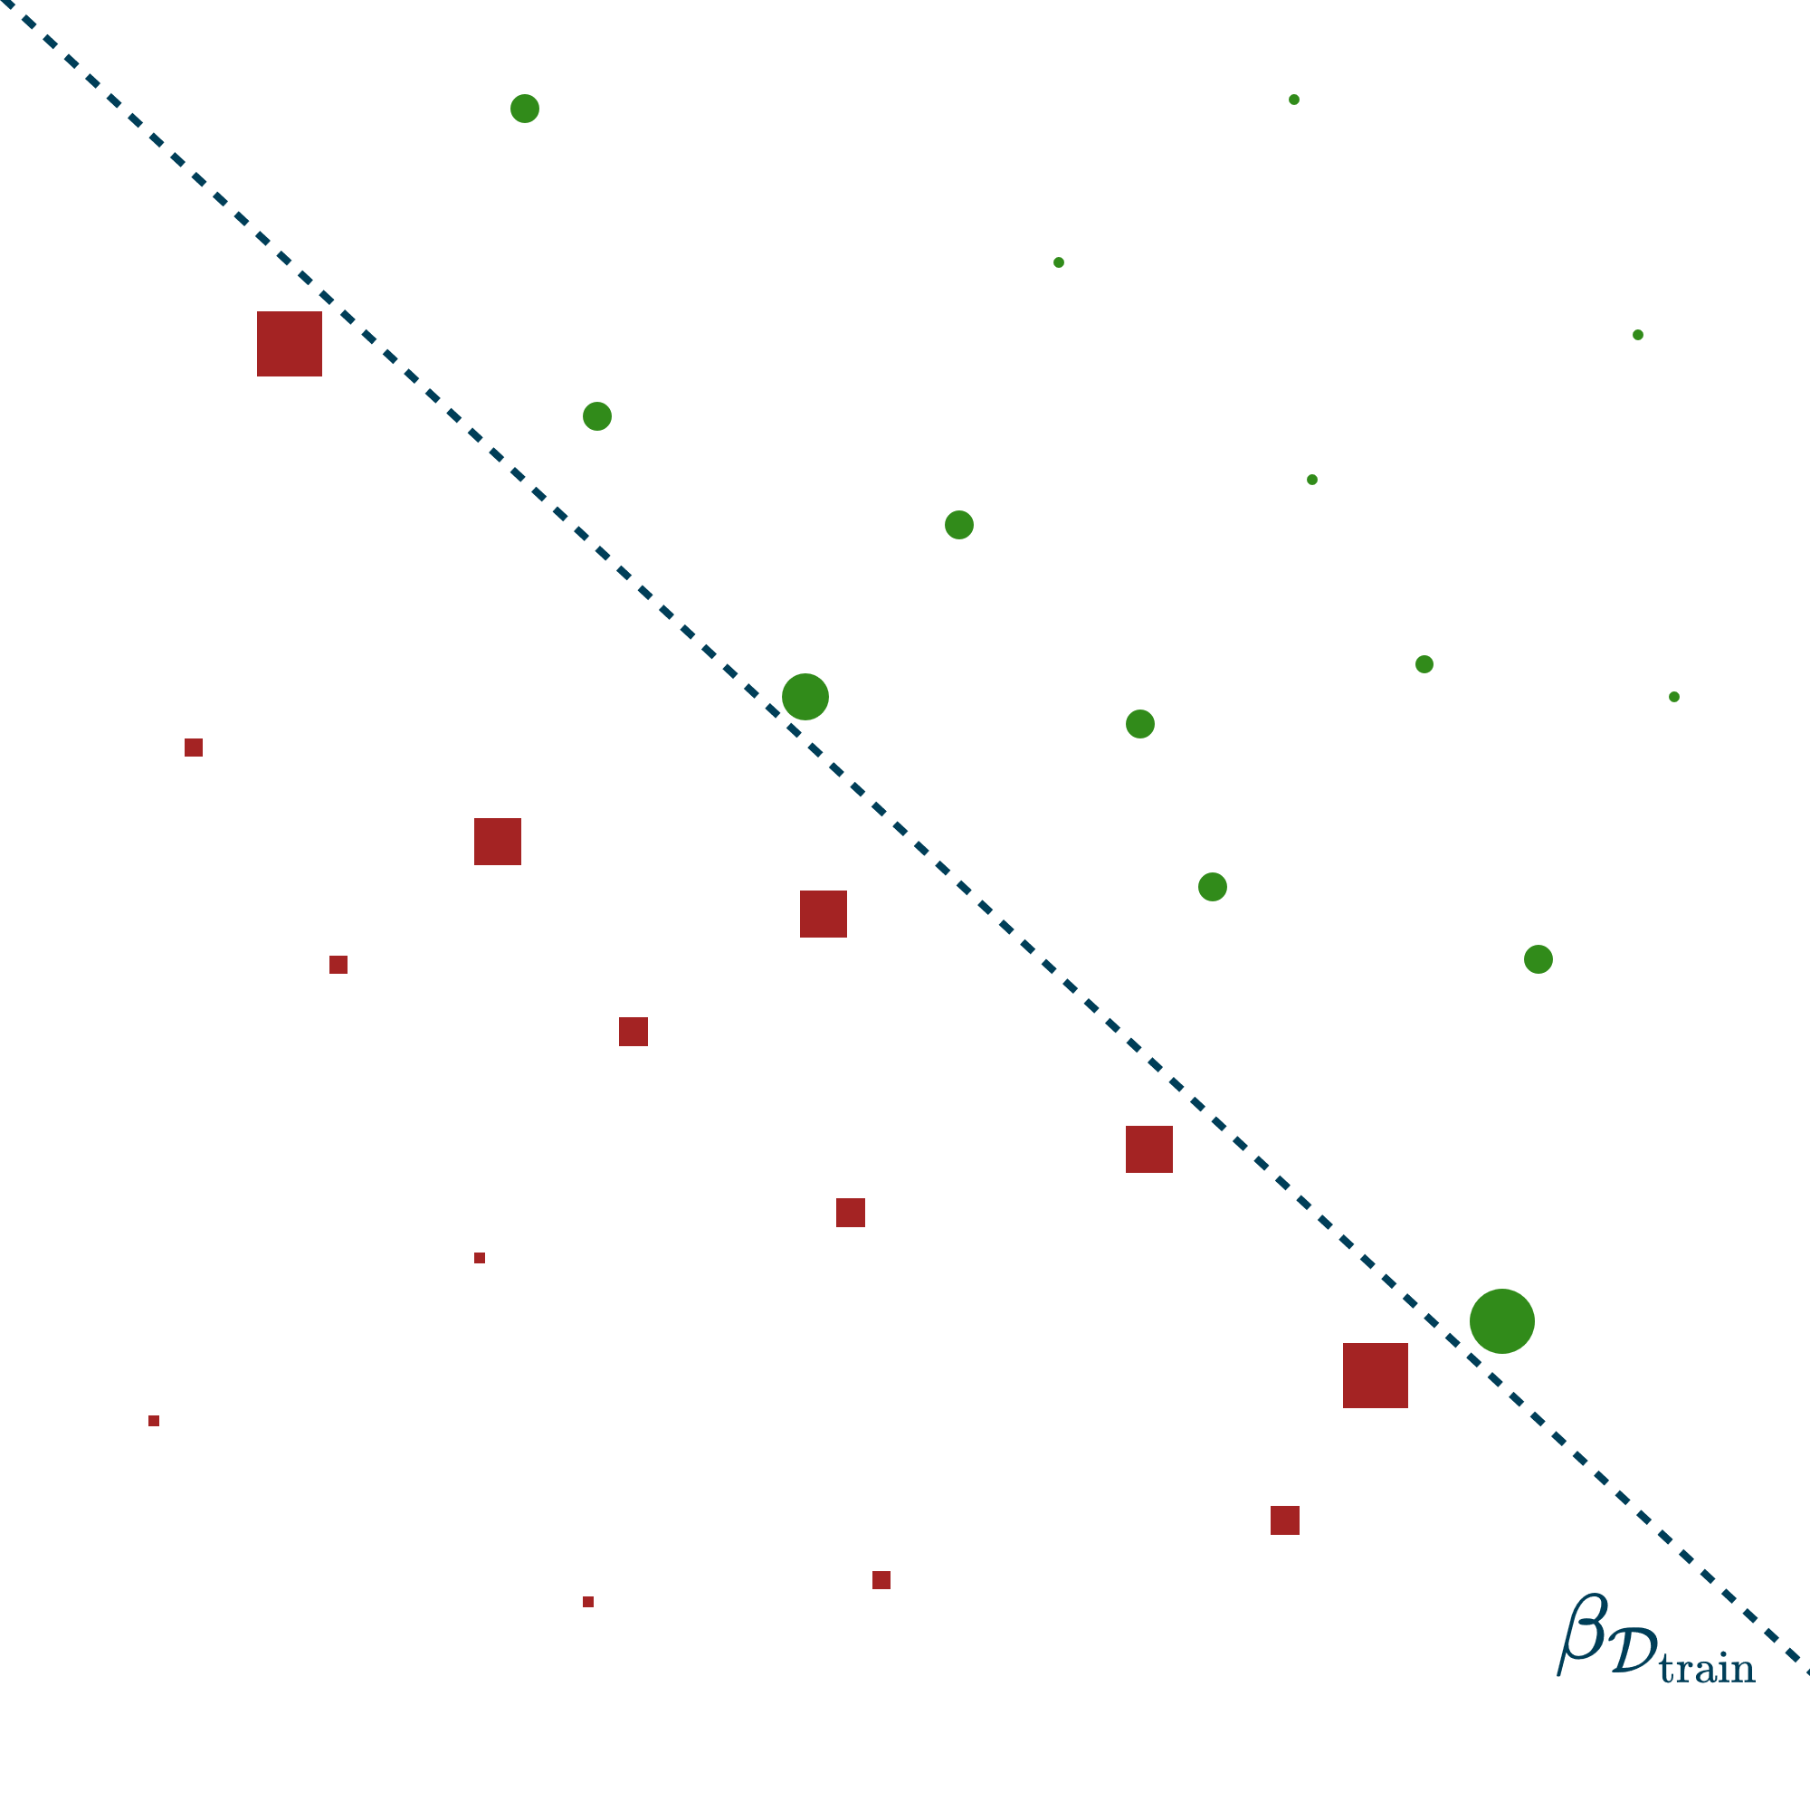
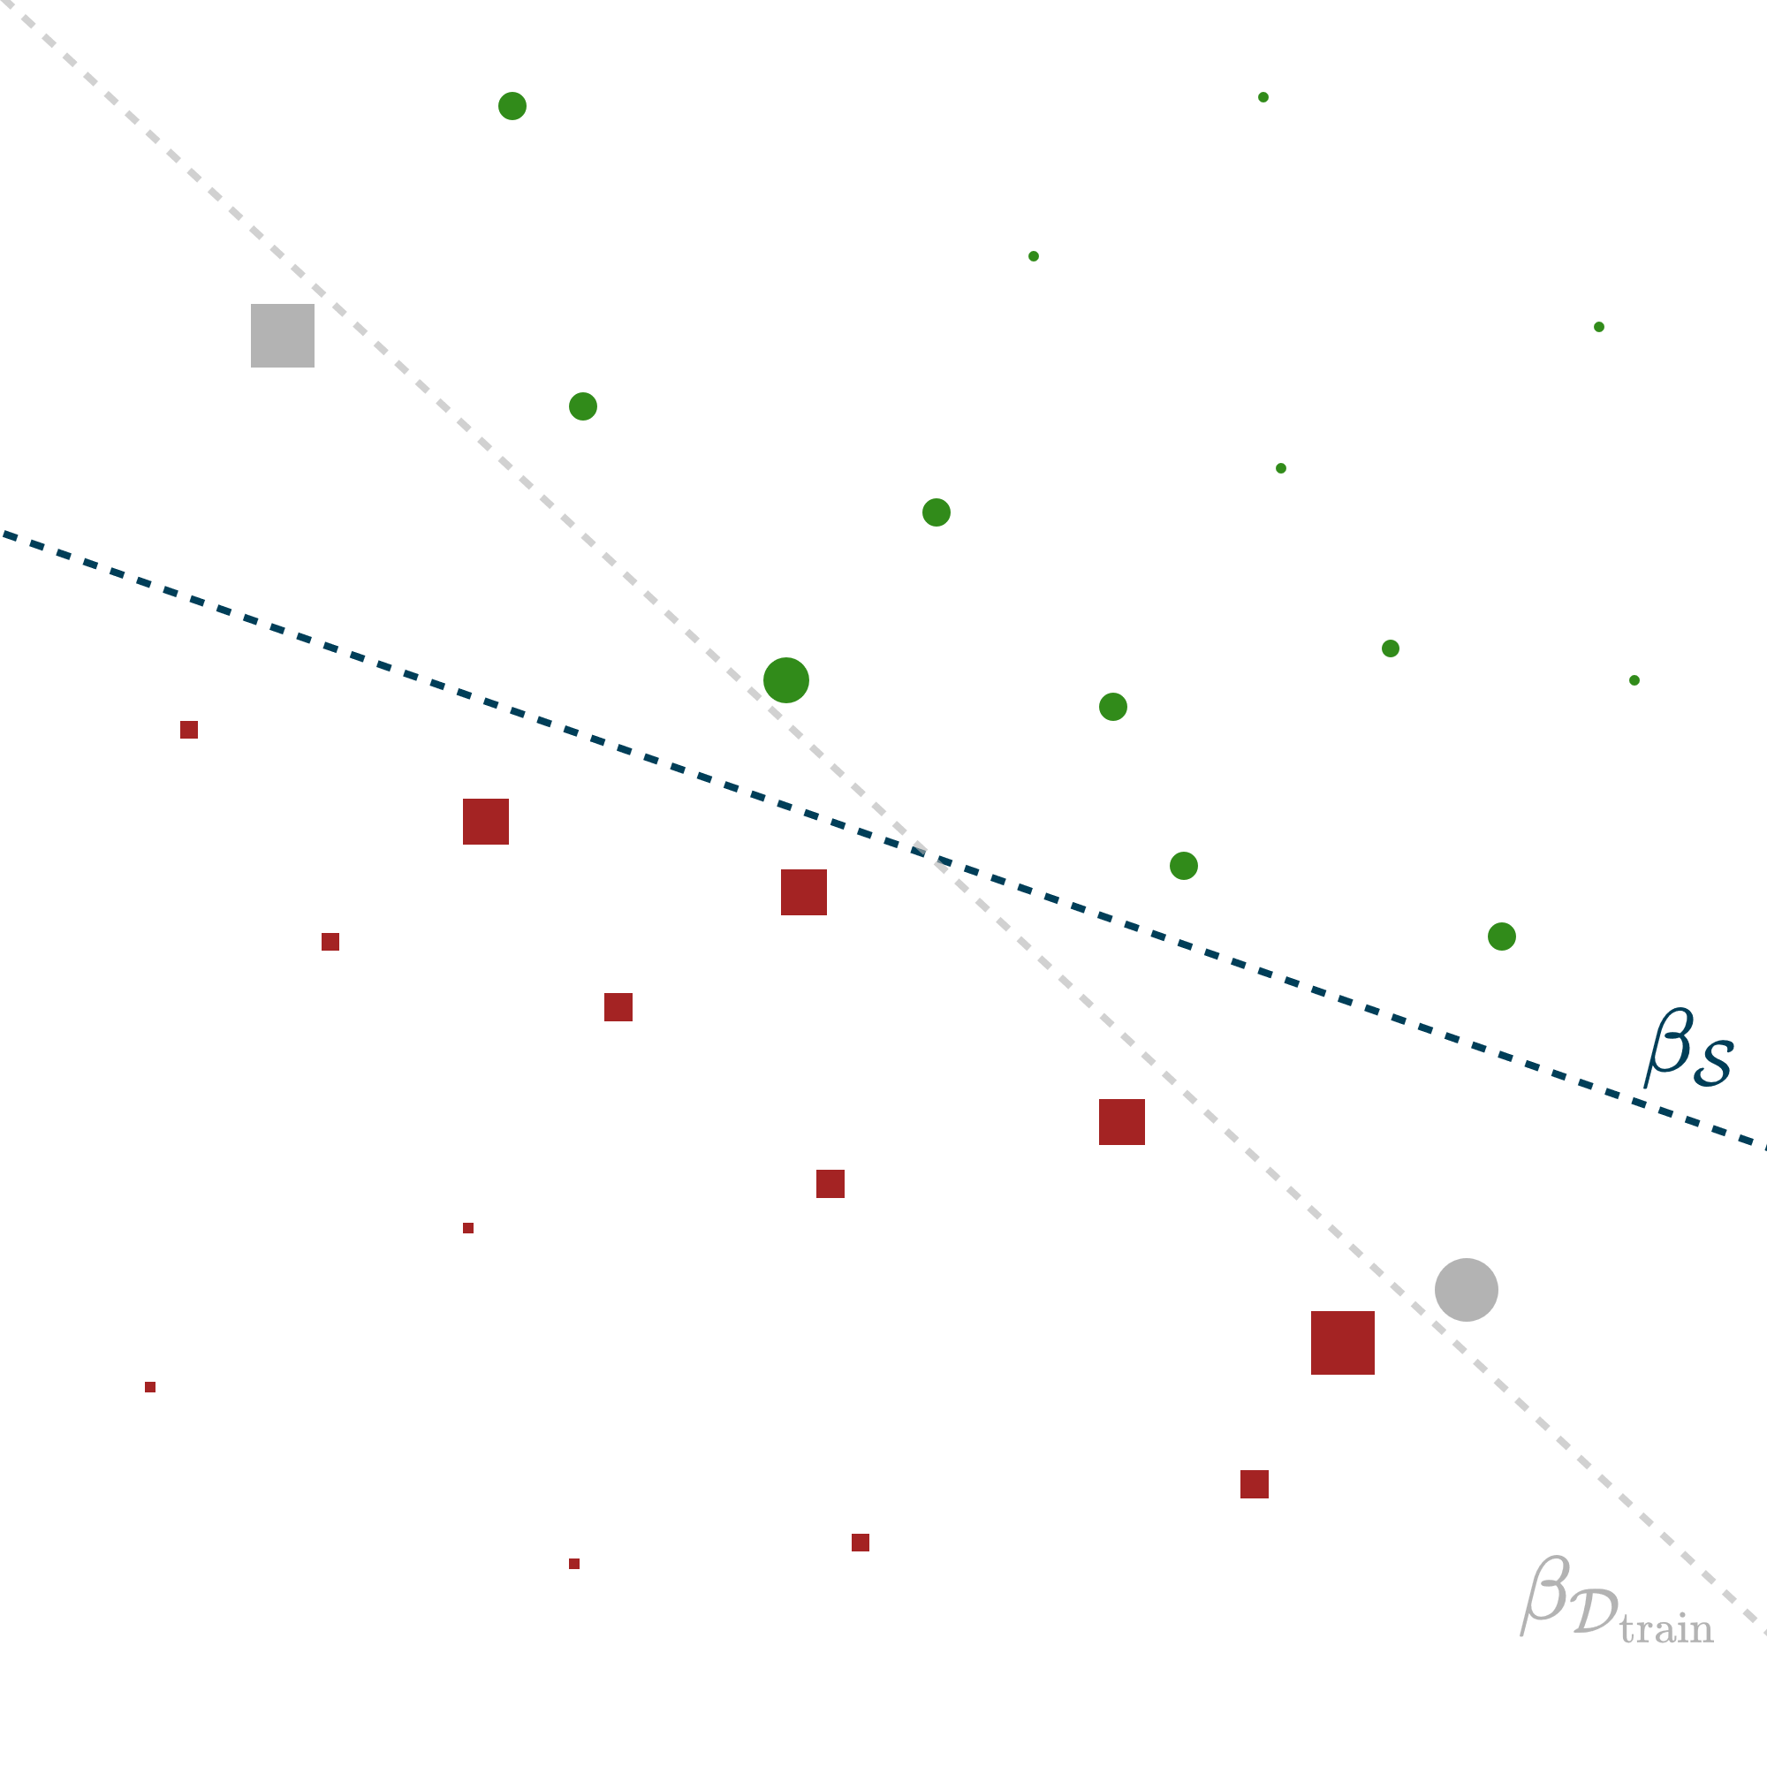

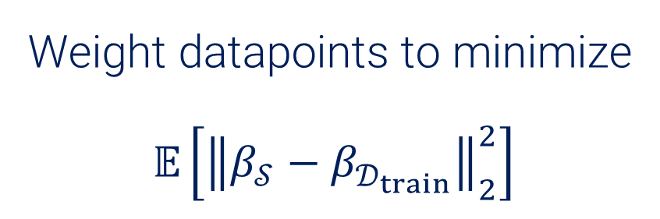
OSMAC (Optimal Subsampling Motivated by the A-Optimality Criterion)
Not all datapoints equally important.
$$⇒$$
Weight datapoints to minimize
$$𝔼\left[{\left\|β_{𝒮}−β_{𝒟_{train}}\right\|}_{2}^{2}\right]$$

Slide 28
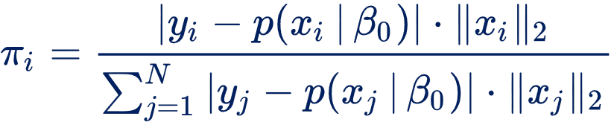

OSMAC: Outline of the method
Sample a small $𝒮_{0}$ uniformly. Obtain pilot estimate $β_{0}$.
Weight datapoints:
Sample $𝒮$ with weights $π_{i}$. Obtain final estimate $β_{𝒮}$.

Slide 29
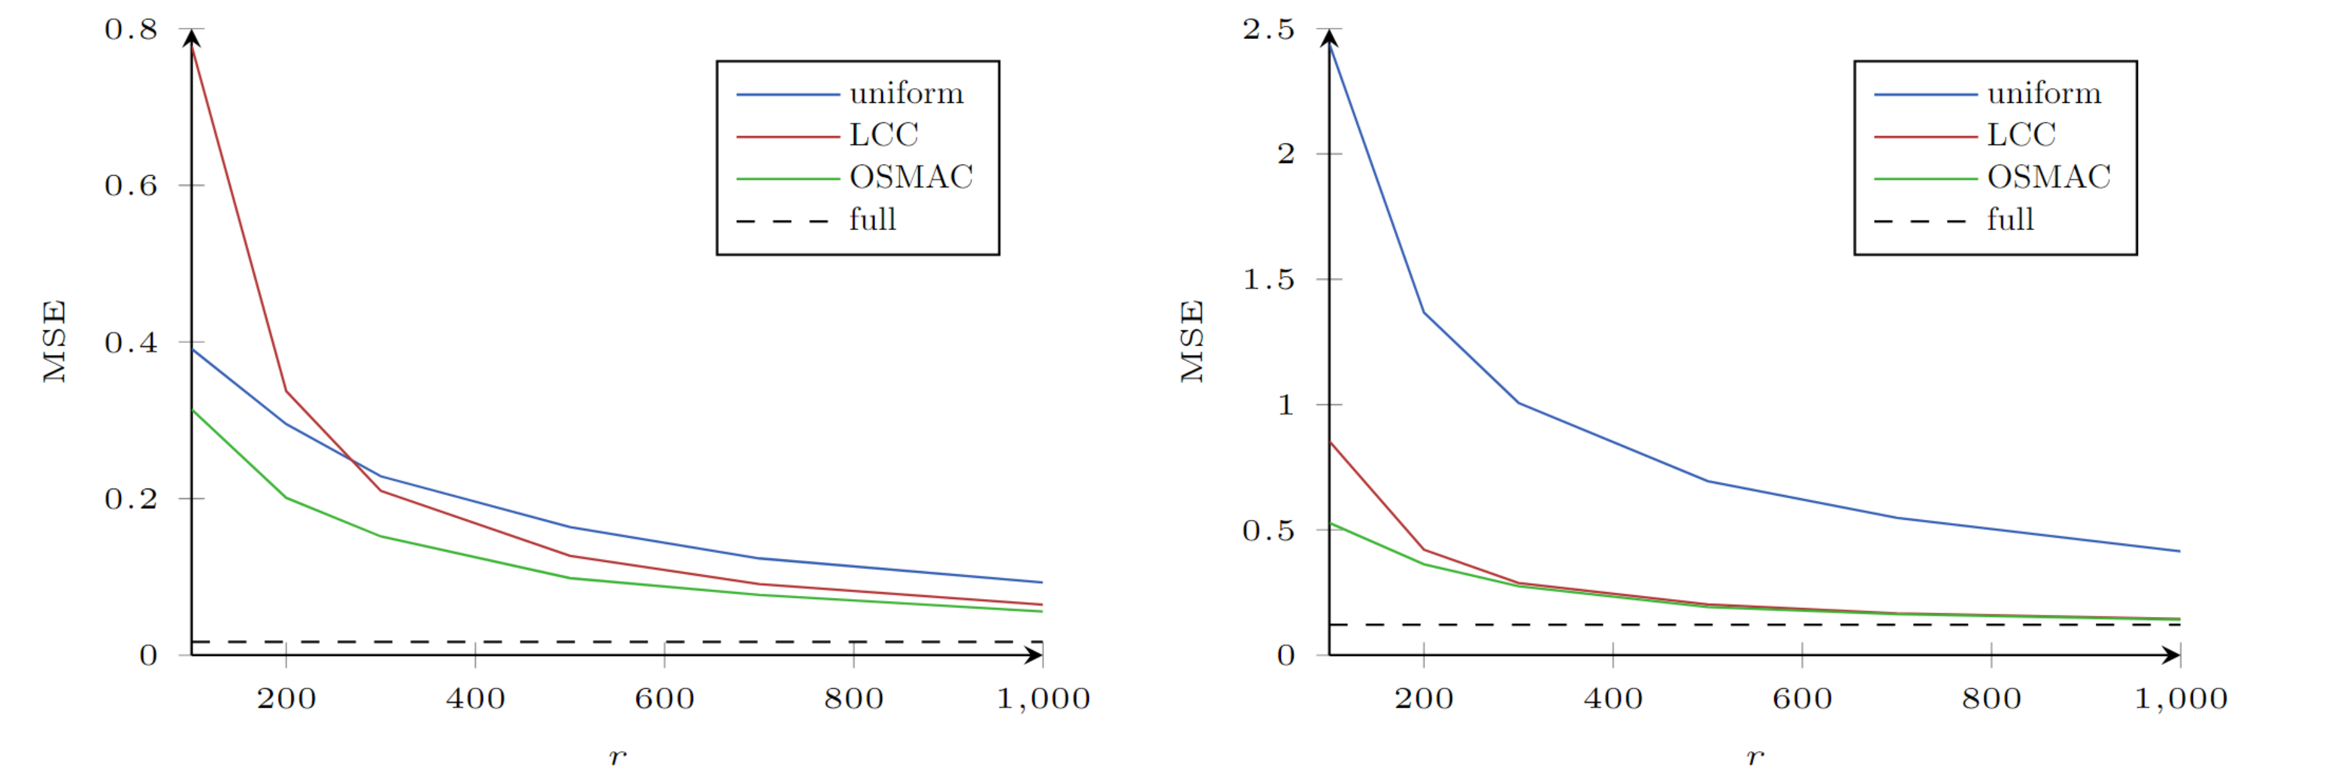
OSMAC: Evaluation
Balanced dataset
Imbalanced dataset (95% positive)
Evaluation on two Logistic Regression tasks

Slide 30

Optimizing Training: 4 approaches
Bag of Little Bootstraps
Sample Size Selection for Gradient Descent
OSMAC
Combine SVMs with $k$-means
Reduce size of $𝒟_{train}$

Slide 31
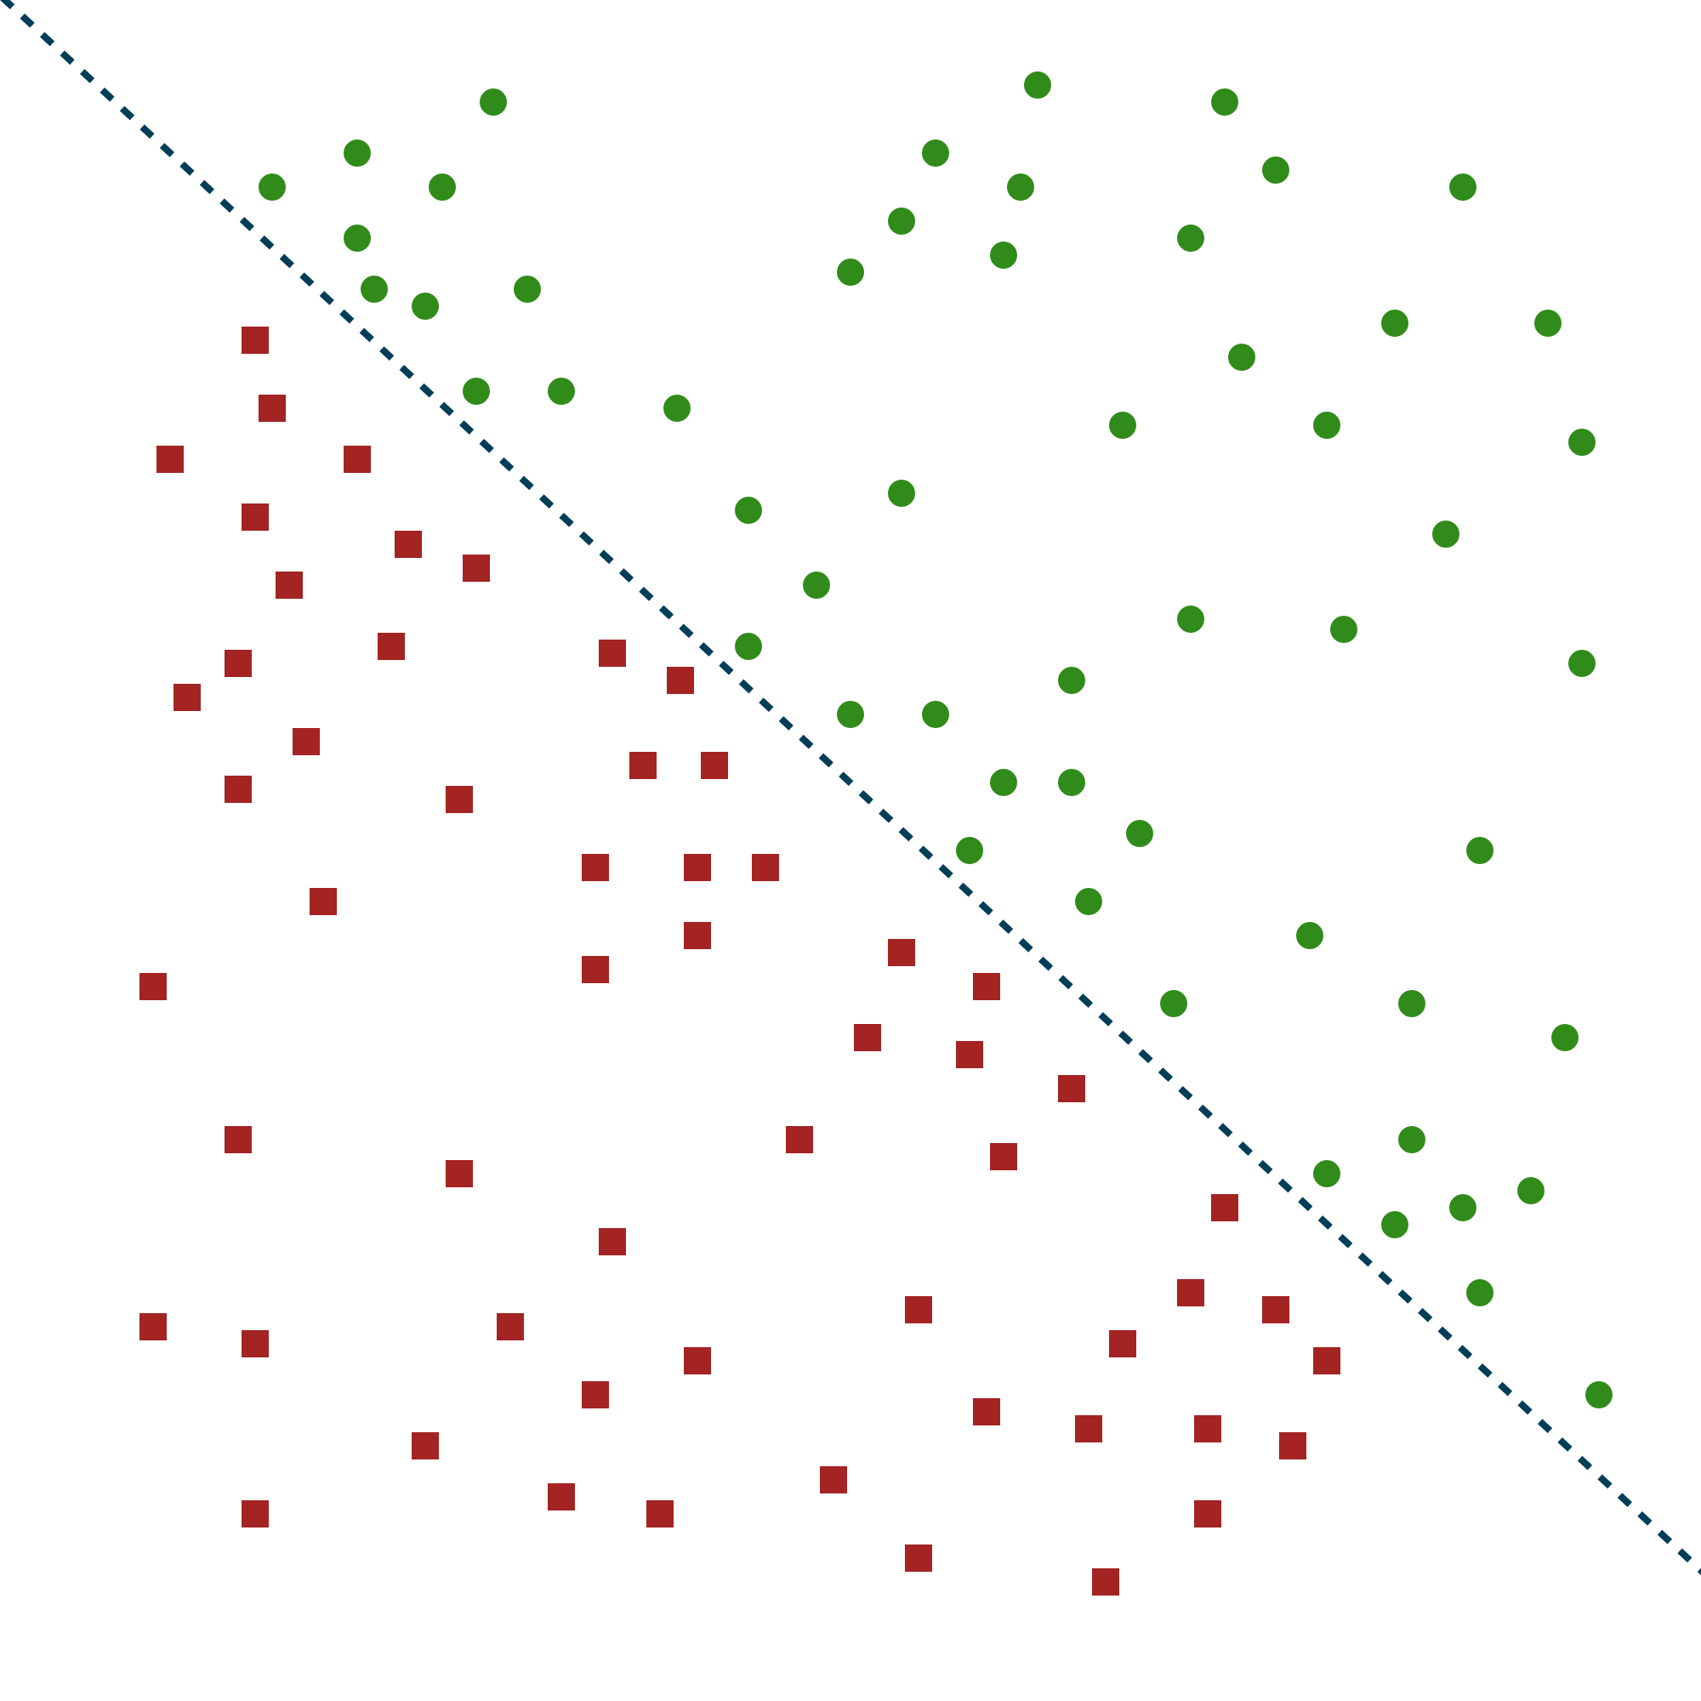
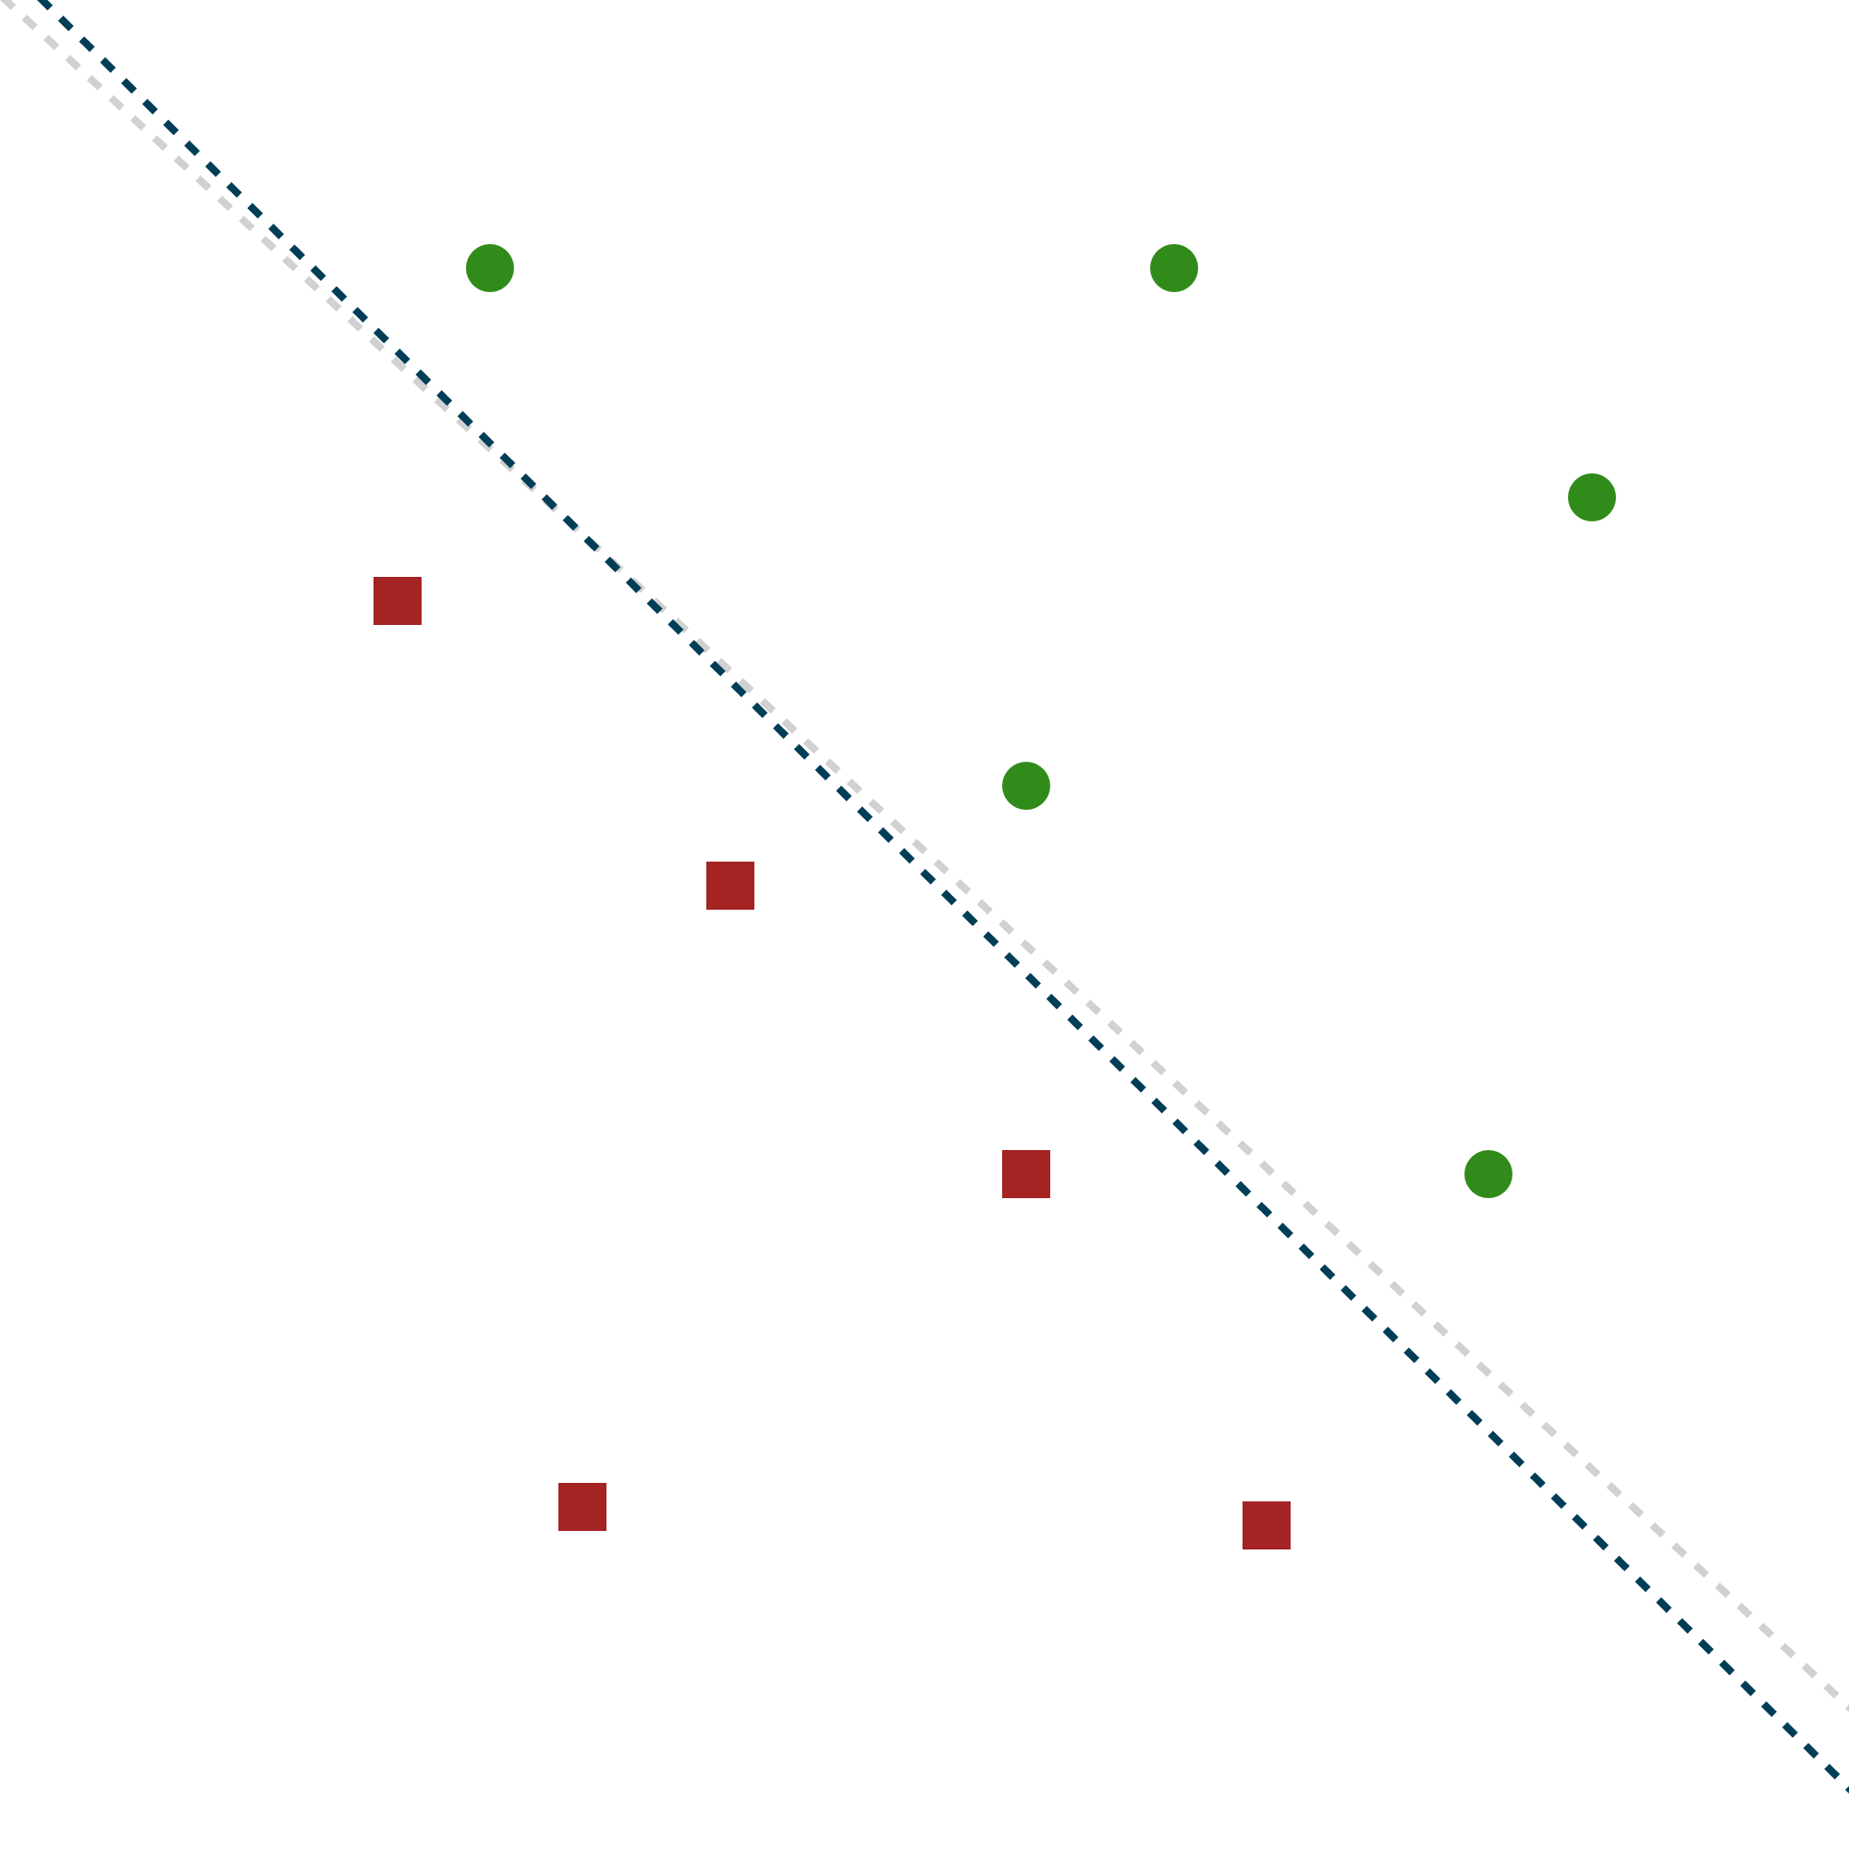


KM-SVM ($k$-means SVM)
Just run $k$-means on each class
before training.
Can be applied to SVMs
and other classifiers.

Slide 32
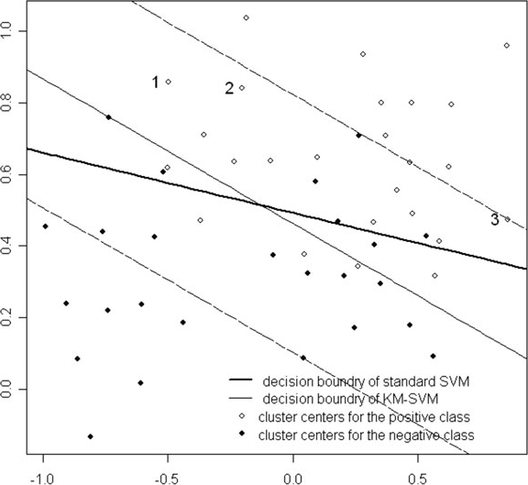
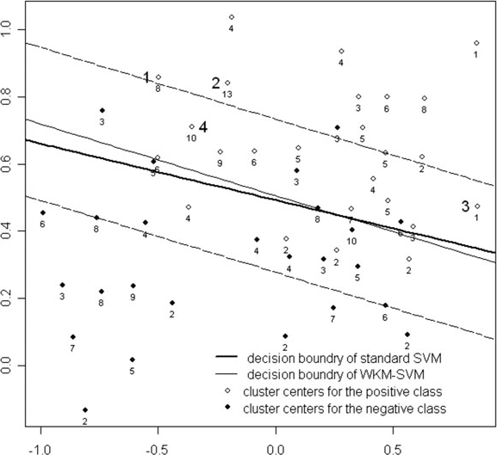

WKM-SVM (Weighted $k$-means SVM)
KM-SVM
WKM-SVM: weight clusters by their size

Slide 33
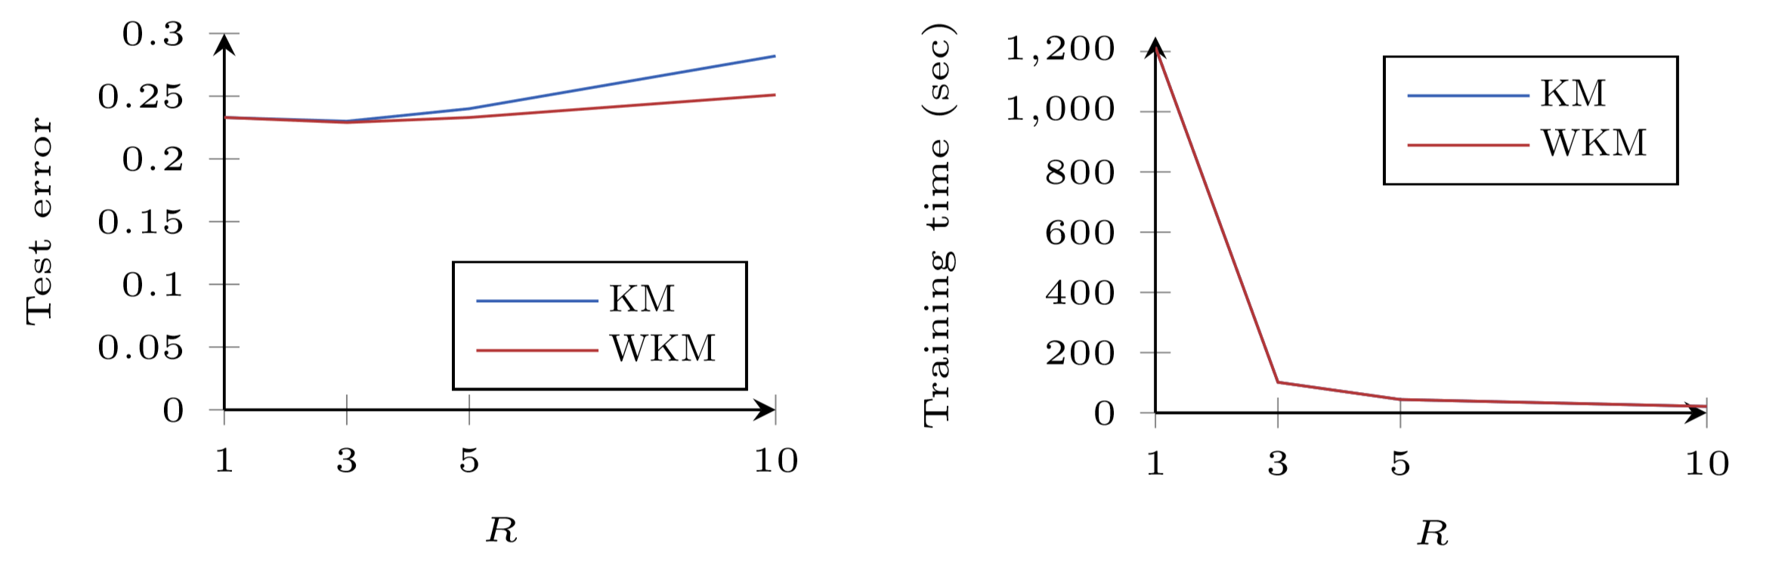

WKM-SVM: Evaluation
with $k= \frac{N}{R}$
Evaluation on the PimaIndiansDiabetes2 dataset

Slide 34
Recap
Hyperparameter Optimization
FABOLAS
Learning Curve Extrapolation
Optimizing Training
Bag of Little Bootstraps
Sample Size Selection for Gradient Descent
OSMAC
WKM-SVM

Slide 35
Thank you!

